Slide 1

Population Growth Analysis
Team members
Jeevan Jyothi Malik - 2411021060959
Akash P Achar - 2411021060956
M Karan Raju - 2411021060144
Harin N - 2411021060391

Slide 2
Introduction
Population Growth Analysis, we are essentially looking at the "pulse" of humanity. It is the mathematical and statistical study of how the number of individuals in a specific area (a country, a city, or the entire planet) changes over a set period.
Defining Population Growth Analysis
At its core, this analysis evaluates the balance between people entering a population and those leaving it.

Slide 3
Objectives
1. Historical Trend Analysis
Objective: Track how the population of a specific country or the entire world has changed over the last 60+ years.
2. Comparative Growth Rates
Objective: Calculate the Annual Growth Rate for different nations and compare them.
3. Regional and Economic Aggregation
4. Ranking and Market Sizing
Objective: Rank countries by population size for any specific year
5. Future Projections (Forecasting)

Slide 4
Datasets and Code Link
Dataset Link - https://www.kaggle.com/datasets/sazidthe1/world- population-data
Python Code link - https://colab.research.google.com/drive/1Wa0ZBwSOtWpKsIRXTF1qKyz2ZE_rYCV5

Slide 5
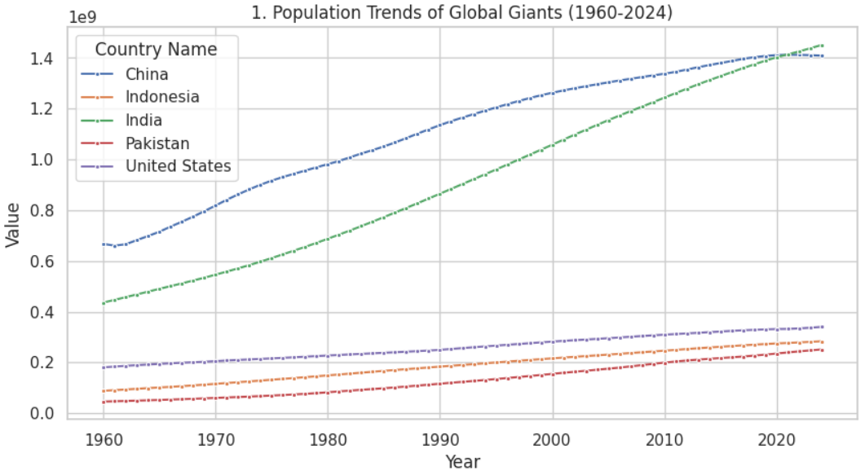
Line Chart

Slide 7
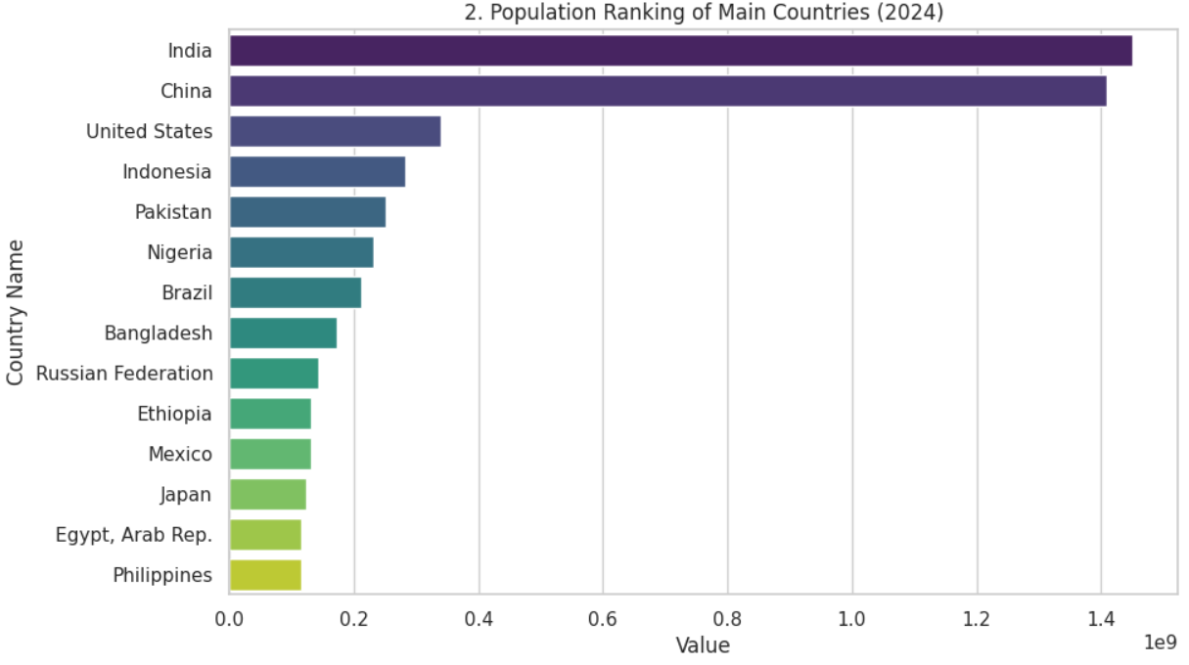
Bar Chart

Slide 8
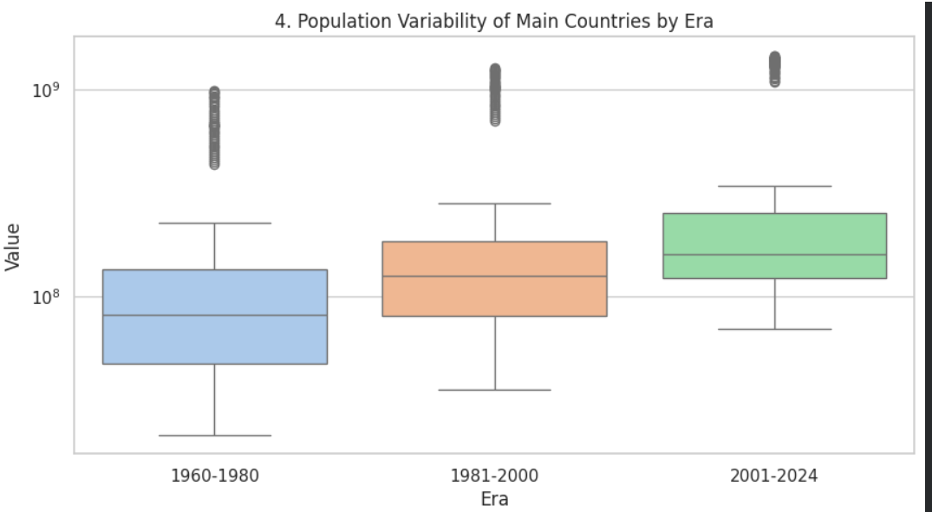
Box Plot

Slide 9
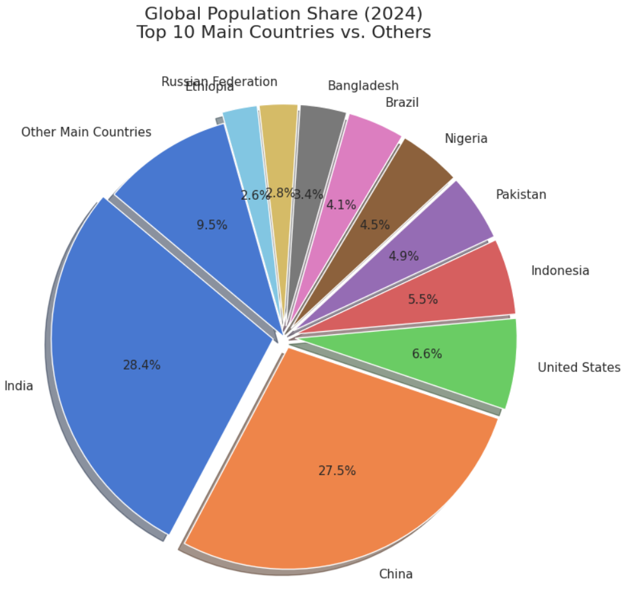
Pie chart
.

Slide 10
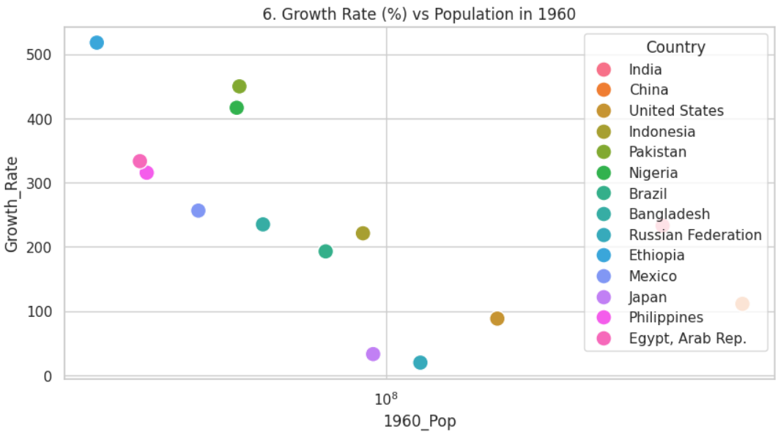
Scatter plot

Slide 11
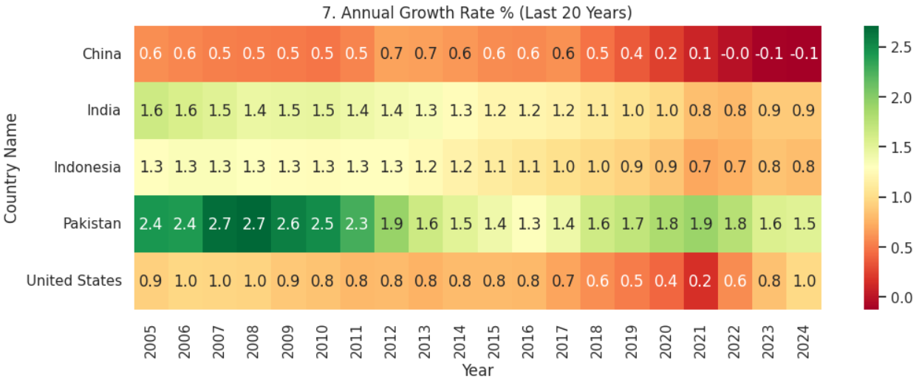
Heatmap

Slide 12
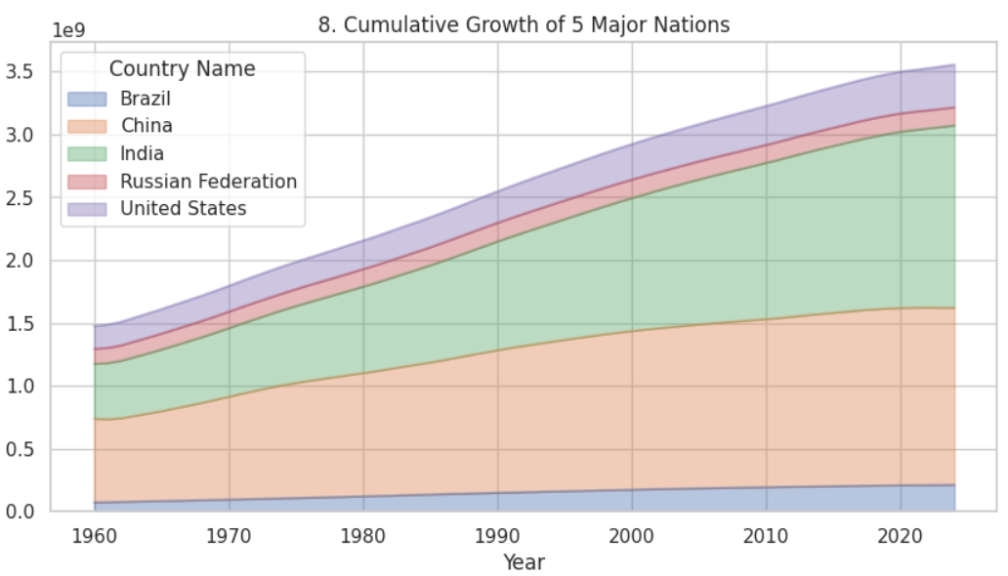
Area Chart

Slide 13
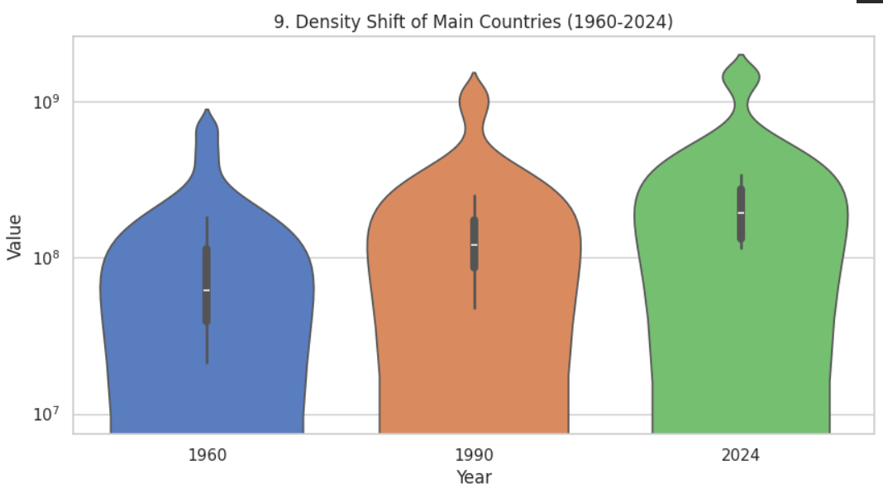
Violin plot

Slide 14
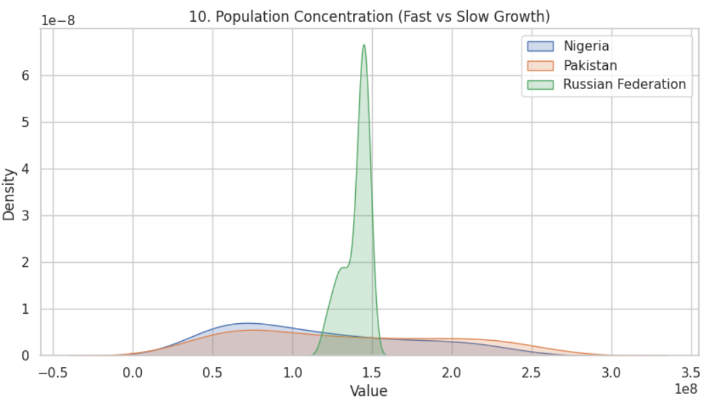
KDE plot

Slide 15
Conclusion
1. Massive Global Population Growth - The total world population has more than doubled in the last 64 years. In 1960, the global population was approximately 3.02 billion. By 2024, it has grown to over 8.14 billion, representing an overall increase of approximately 169%.
2. India Overcomes China as the Most Populous Nation
3.The world population reached its peak annual growth rate of 2.14% in 1963.
4. The total population is still rising, the momentum of growth is fading significantly.

Slide 16
Conclusion
Top 5 Most Populous Countries (2024)
As of 2024, the top five nations by population are:
India: ~1.45 billion
China: ~1.41 billion
United States: ~337 million
Indonesia: ~280 million
Pakistan: ~247 million

Slide 17


